Slide 1

Global Office 365 Bootcamp – Madrid, Spain AZURE PARA OFFICE365 DEVELOPERS
Robert Bermejo
Team Leader

Slide 2









Robert Bermejo Blasco
Team Leader ENCAMINA
Organizador meetup CATzure (@cat_zure)
www.robertbermejo.com
@robertbemejo
bermejoblasco@live.com
https://es.linkedin.com/in/robert-bermejo-blasco-75a73b2
http://www.compartimoss.com/autores/robert-bermejo

Slide 3
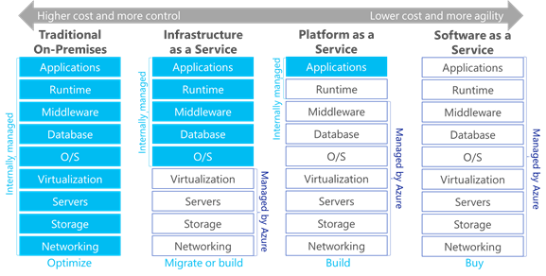
Cloud Models

Slide 4
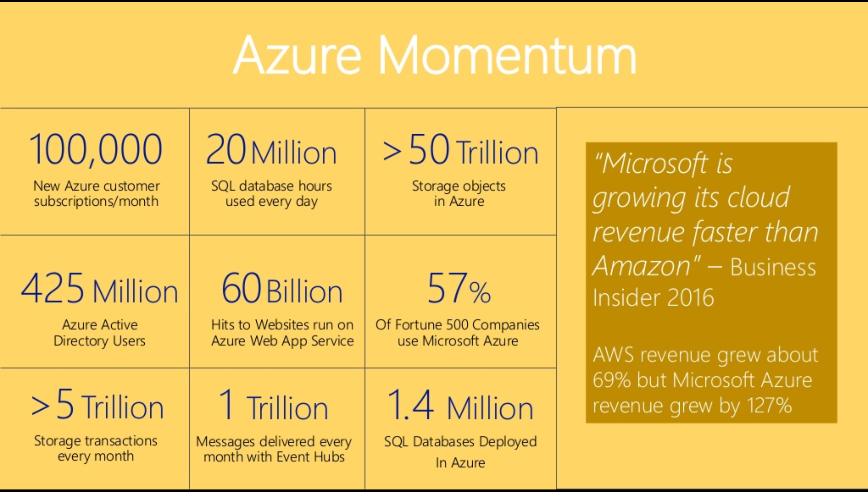
Why Azure?

Slide 5



Slide 6
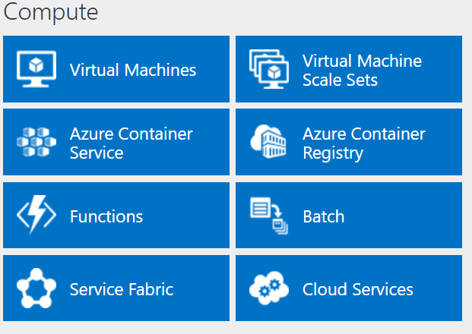
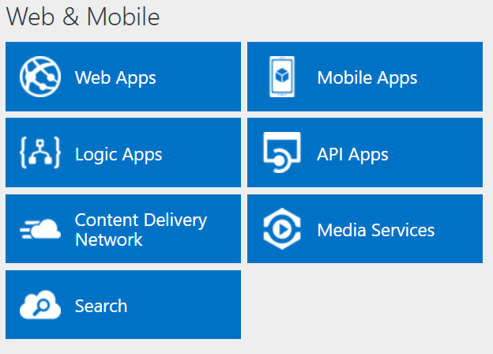
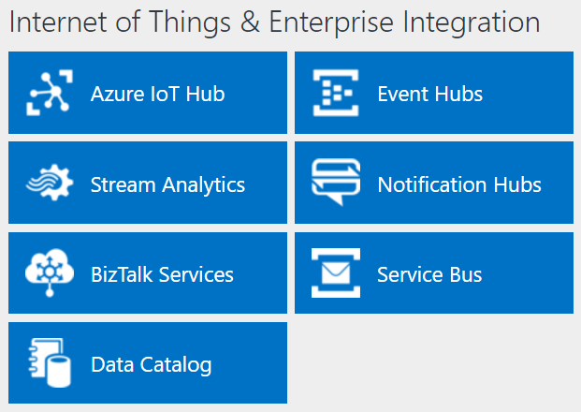
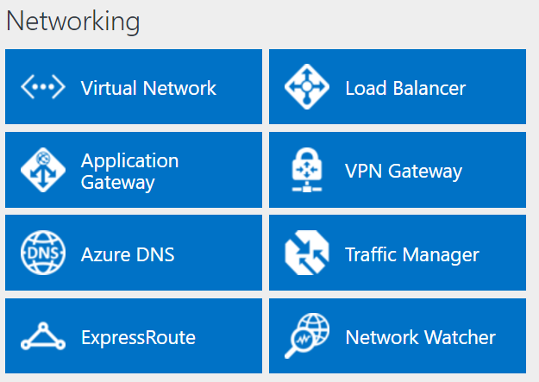
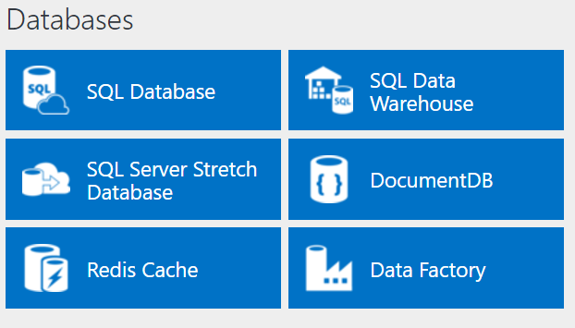
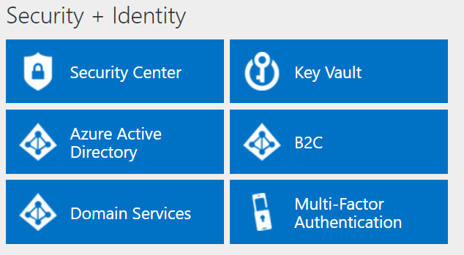
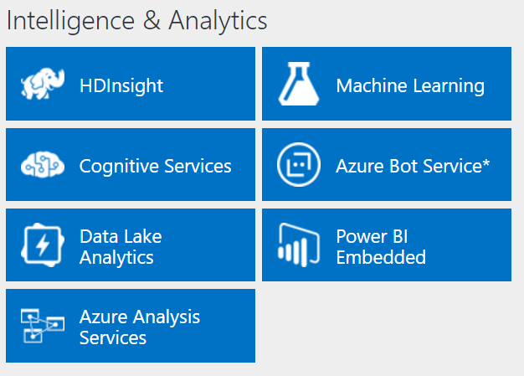
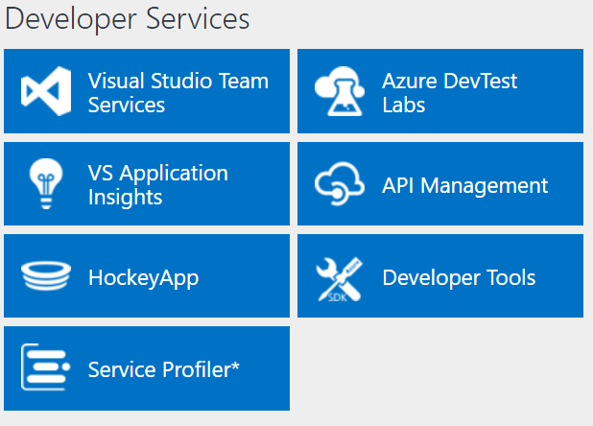
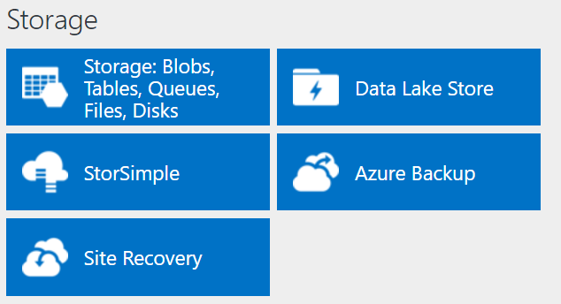
http://azureplatform.azurewebsites.net/
* Preview Services

Slide 7
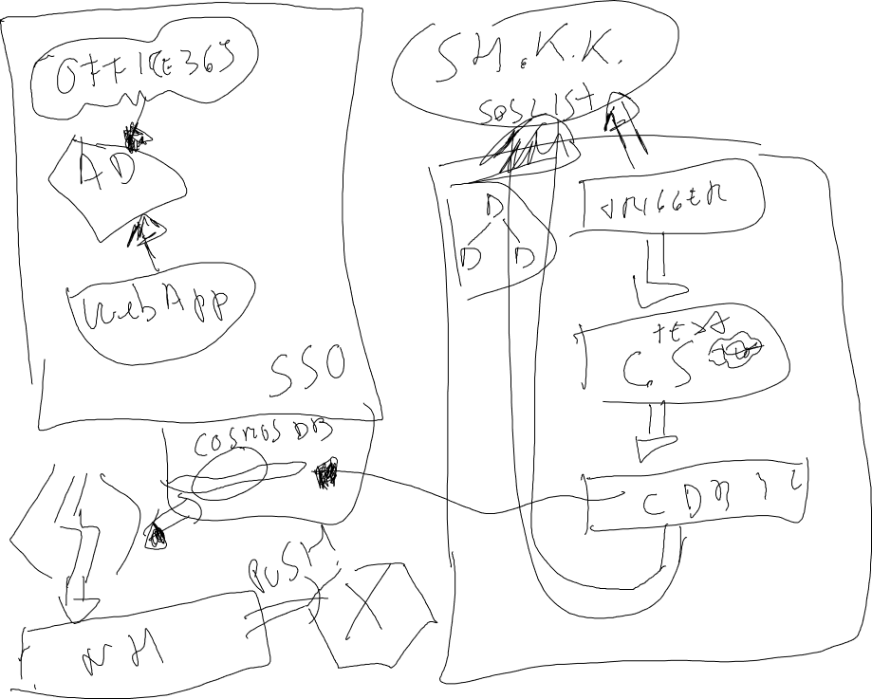

Slide 8









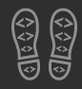
Enjoy the Bootcamp
https://github.com/bermejoblasco/Office365BootcampLab
https://github.com/CompartiMOSS/Global-Office-365-Developer-Bootcamp/tree/master/Azure_para_office365_developers

Slide 9

Call to action
(Recommendation to Bootcamp organizers and speakers: This slide can be used at the end of the Bootcamp to have attendees to fill online feedback form and recommendation for their ongoing learning and app development on Office 365 platform. Please keep the first three bullet points, you can update the last bullet point to be the user group or community that you are leading that you’d like attendees to join and learn more. Please keep the first feedback bullet point at the top and feel free to re-arrange the rest of bullet point orders. Thanks.
Share your feedback on Bootcamp at https://aka.ms/o365devbootcampfeedback
Join Office 365 developer program https://dev.office.com/devprogram to leverage all resources for Office 365 development learning
Build applications on Office 365 platform
Attend MVP led local community events to continue learning on Office 365 development

